Slide 1
3.03
Feature engineering, feature scaling, and other regressions
Level 7 Artificial Intelligence (AI) Data Specialist
Python, Tools and Steps to Build AI Models
Georgina Thomas
g.thomas@learn-tech.com

Slide 2
KSBs
S25: Select and use programming languages and tools, and follow appropriate software development practices

Slide 3
P16
P16: Pass criterion: Describes how they applied appropriate scientific and technological methods for machine learning, AI and data science solutions, services and platforms to deliver business outcomes outlining successes and challenges.
Clarification and suggestions: To address this assessment criterion, the apprentice needs to describe how they applied scientific and technological methods in machine learning, AI, and data science, to deliver business outcomes.
The apprentice should also outline the successes and challenges they encountered:
Applying Scientific and Technological Methods
1. Problem Definition:
• Identify Business Objectives: Clearly define the business problem or objective they aim to solve with AI or data science.
• Set Goals: Establish specific, measurable goals for their project.
2. Data Collection and Preparation:
• Gather Data: Collect relevant data from various sources, ensuring it is comprehensive and relevant.
• Data Cleaning: Clean the data to remove errors, duplicates, and inconsistencies.
• Data Transformation: Transform the data into a suitable format for analysis, including normalisation and feature engineering.
3. Model Selection and Development:
• Choose Algorithms: Select appropriate machine learning algorithms or AI models based on the problem and data characteristics.
• Model Training: Train the models using the prepared data, adjusting parameters to optimise performance.
• Validation and Testing: Validate the models using a separate dataset to ensure they generalise well to new data.
4. Implementation and Deployment:
• Integrate Solutions: Implement the models into the business processes or systems.
• Monitor Performance: Continuously monitor the performance of the models and make adjustments as needed.
5. Evaluation and Feedback:
• Measure Outcomes: Evaluate the impact of the AI or data science solution on the business objectives.
• Gather Feedback: Collect feedback from stakeholders to refine and improve the solution.
Successes could include:
1. Improved Decision-Making
2. Increased Efficiency
3. Enhanced Customer Experience
Challenges could include:
1. Data Quality Issues
2. Model Performance
3. Integration Difficulties
4. Stakeholder Buy-In

Slide 4
P9
P9: Pass criterion: Manipulates and analyses complex datasets and critically evaluates arguments, assumptions, abstract concepts and data (that may be incomplete) to make recommendations and to enable a business solution or range of solutions to be achieved.
This assessment criterion involves several key skills and abilities:
1. Manipulating and Analysing Complex Datasets: This means the apprentice should be able to handle large and intricate sets of data, using various tools and techniques to extract meaningful insights. This often involves cleaning the data, identifying patterns, and using statistical or computational methods to analyse it.
2. Critically Evaluating Arguments, Assumptions, and Abstract Concepts: The apprentice needs to assess the validity and reliability of different arguments and assumptions. This involves questioning the underlying premises and logic, and considering alternative perspectives. Abstract concepts might include theoretical models or frameworks that need to be understood and applied appropriately.
3. Dealing with Incomplete Data: Often, data may be missing or incomplete. The apprentice should be able to make informed decisions despite these gaps, using methods such as imputation, estimation, or sensitivity analysis to handle the missing information.
4. Making Recommendations: Based on their analysis, the apprentice should be able to propose actionable recommendations. These should be well-supported by their data analysis and critical evaluation, and should aim to address the business problem at hand.
5. Enabling Business Solutions: Finally, their recommendations should be practical and feasible, helping the business to implement effective solutions. This might involve suggesting a range of possible solutions and evaluating their potential impact.
In essence, this criterion assesses their ability to use data and critical thinking to solve complex business problems.

Slide 5
D6
D6: Distinction criterion: Evaluates solutions and explains the risks and implications of the AI data science requirements and alternative approaches and ways to address them.
Clarification and suggestions: This distinction criterion requires the apprentice to evaluate the selected solution(s) used in their project and explain the risks and implications of the AI and the data science requirements, as well as alternative approaches that they could have chosen, consider:
Evaluating Solutions
1.Define the Problem:
•Clearly articulate the business problem or objective that the AI or data science solution aimed to address.
2.Identify Potential Solutions:
•List all possible AI and data science solutions that could have addressed the problem. This might include different algorithms, models, or data processing techniques.
3.Criteria for Evaluation:
•Effectiveness: How well did each solution address the problem?
•Scalability: Can the solution handle increasing amounts of data or users?
•Cost: What are the financial implications of implementing the solution?
•Complexity: How complex is the solution to implement and maintain?
•Time to Implement: How long did it take to develop and deploy the solution and how does this compare with alternative but rejected options?
4.Compare the solutions based on the criteria above. The apprentice could consider using a scoring system or a decision matrix to quantify the evaluation.
Explaining Risks and Implications
1.Technical Risks:
•Data Quality: Poor quality data can lead to inaccurate models and predictions.
•Model Performance: The chosen model might not perform well on unseen data, leading to unreliable results.
•Scalability Issues: The solution might not scale well with increasing data or user load.
2.Operational Risks:
•Implementation Challenges: Difficulties in integrating the solution with existing systems.
•Maintenance: Ongoing maintenance and updates required to keep the solution effective.
•Resource Allocation: Ensuring that there are enough skilled personnel to manage the solution.
3.Ethical and Legal Risks:
•Bias and Fairness: The model might inadvertently introduce or perpetuate biases.
•Privacy Concerns: Handling sensitive data must comply with privacy regulations like GDPR.
•Transparency: Ensuring that the AI decisions are explainable and transparent to stakeholders.
4.Business Implications:
•Cost-Benefit Analysis: Weighing the costs of implementation against the expected benefits.
•Impact on Stakeholders: How the solution affects different stakeholders, including employees, customers, and partners.
•Strategic Alignment: Ensuring that the solution aligns with the overall business strategy and goals.
Alternative Approaches that they could have taken:
1.Different Algorithms or Models:
•Consider using different machine learning algorithms or models that might be more suitable for the problem.
2.Data Augmentation:
•Enhance the dataset by adding more data or using techniques like data augmentation to improve model performance.
3.Hybrid Approaches:
•Combine multiple models or techniques to leverage the strengths of each.
4.Incremental Implementation:
•Start with a simpler solution and gradually enhance it. This allows for quicker deployment and iterative improvements based on feedback.

Slide 6
Today’s Objectives
Understand and apply different feature engineering techniques.
Understand different techniques of the target transformation.
Identify and apply other regression models that might be more appropriate for your data.

Slide 7
Recap

Slide 8
LR Assumptions(Recap)
Linearity – the relationship between X and the mean of Y is linear.
Mean of Residuals - The mean of residuals should be zero.
Homoscedasticity - Homoscedasticity means that the residuals have equal or almost equal variance across the regression line.
Normality of errors – the errors should be normally distributed.
Independence – no perfect correlation. The predictors are independent of each others.

Slide 9
Feature Engineering

Slide 10
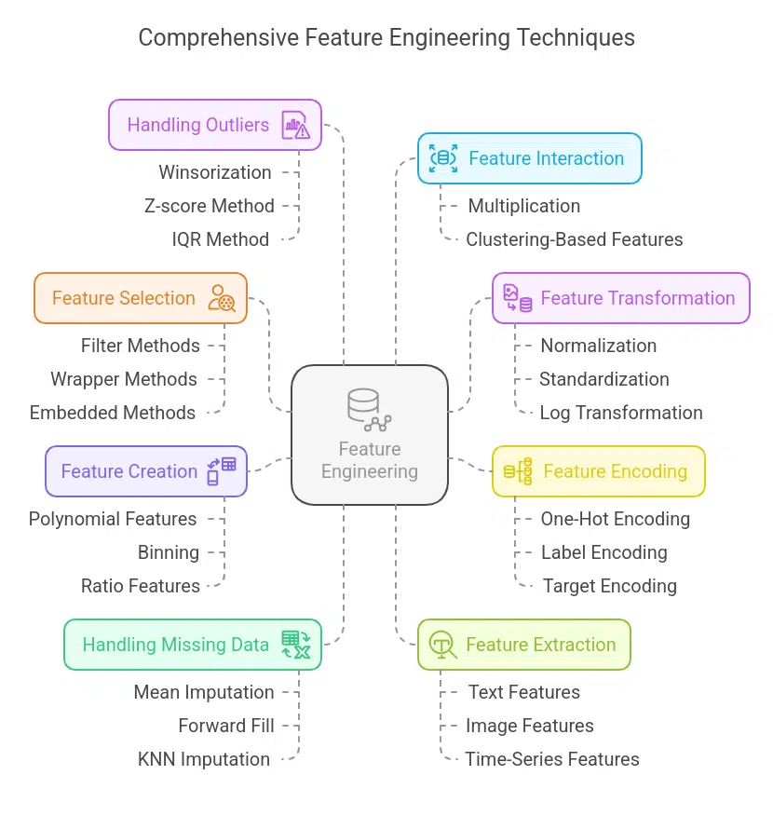
Feature engineering techniques
“Feature engineering is the art of converting raw data into useful input variables (features) that improve the performance of machine learning models. It helps in choosing the most useful features to enhance a model’s capacity to learn patterns & make good predictions.
Feature engineering encompasses methods like feature scaling, encoding categorical variables, feature selection, and building interaction terms.”
https://www.mygreatlearning.com/blog/what-is-feature-engineering/

Slide 11
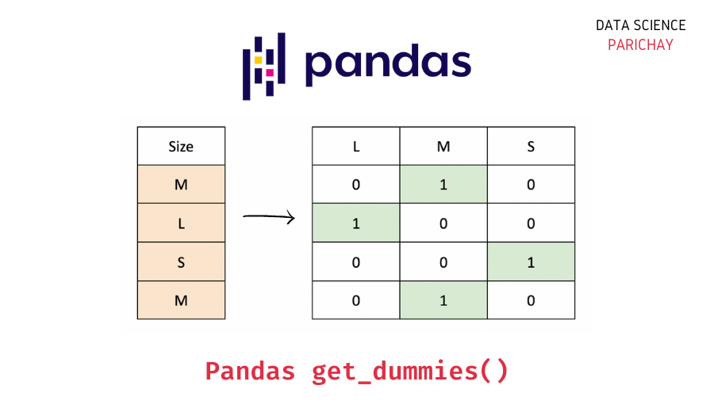
Feature encoding – One-Hot Encoding(Dummy columns)
"The pandas get_dummies() function is used to convert a categorical variable to indicator/dummy variables (columns). It returns the dummy coded data as a pandas DataFrame."
https://datascienceparichay.com/article/pandas-get-dummies-function/

Slide 12
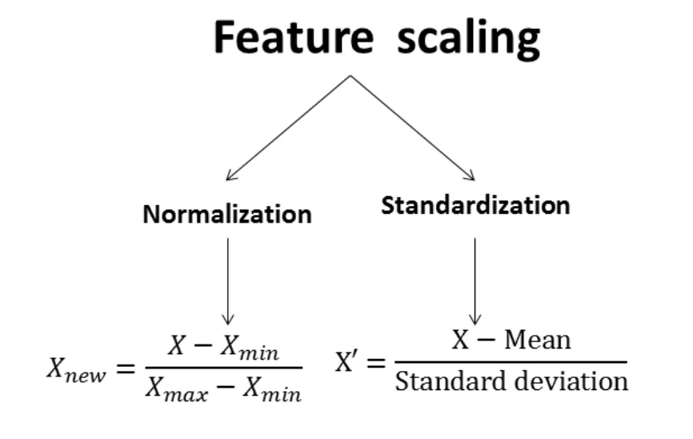
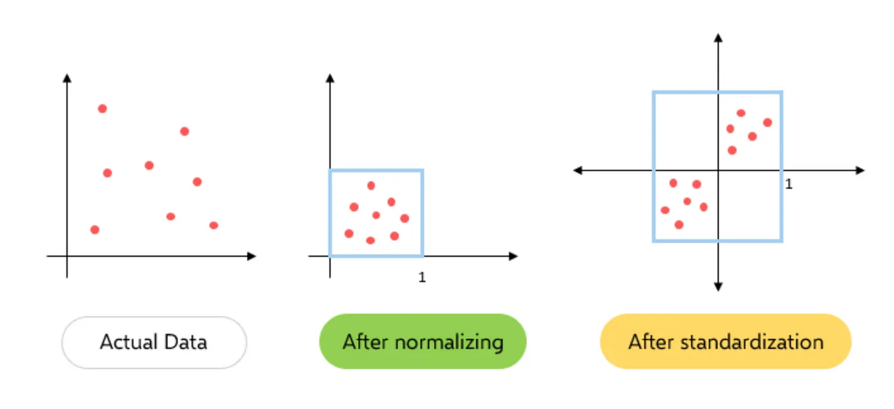
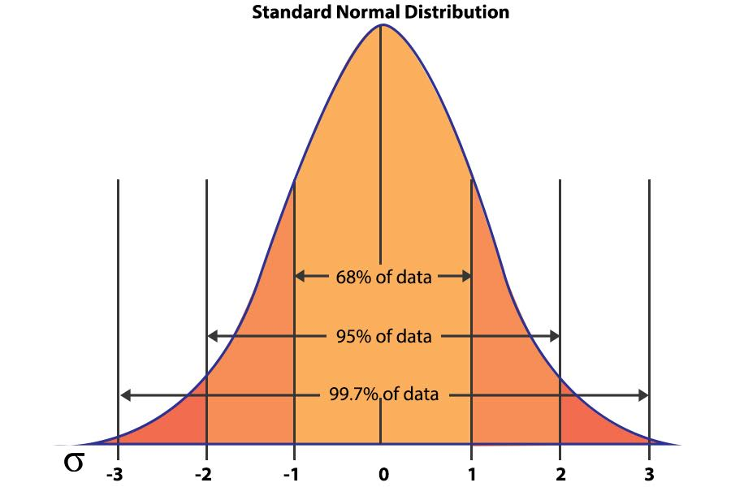
Feature scaling
https://blog.alliedoffsets.com/standardization-the-secret-to-better-data-science

Slide 13
Target transformation

Slide 14
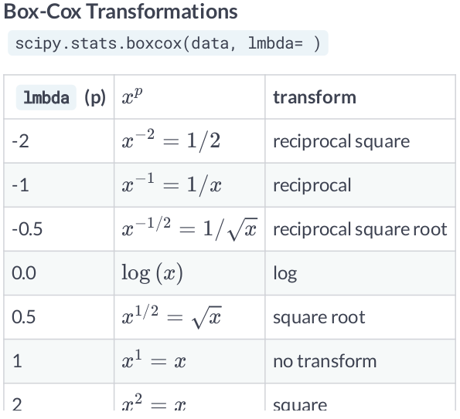
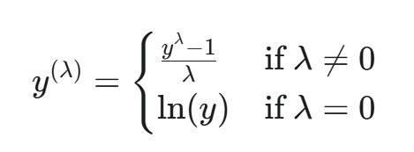
Box-Cox function
https://goldinlocks.github.io/Data-distributions-transformations/

Slide 15
Non-Linear Regression models

Slide 16
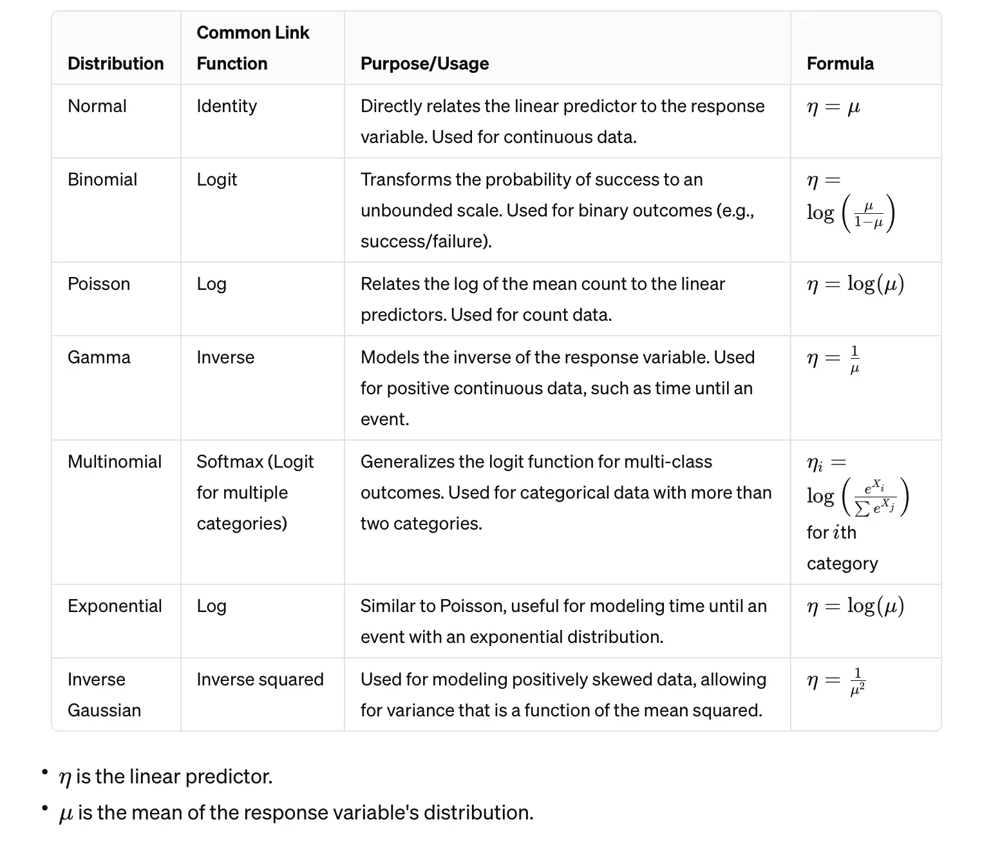
Other Regressions
For the diamond’s prices
https://medium.com/@sahin.samia/a-comprehensive-introduction-to-generalized-linear-models-fd773d460c1d

Slide 17
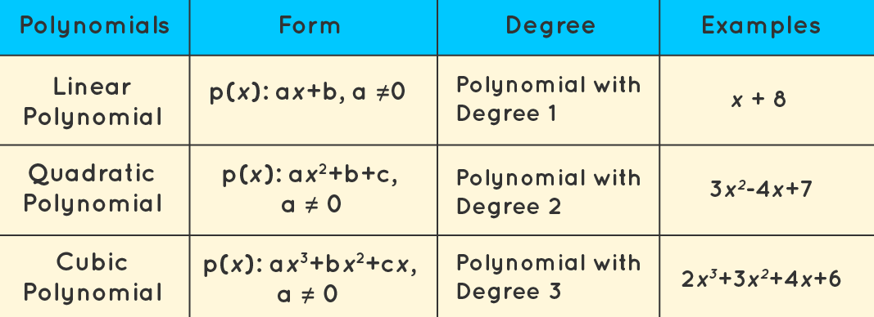
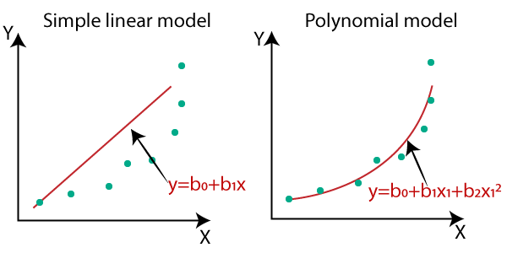
Polynomial Regression
https://www.analyticsvidhya.com/blog/2021/10/understanding-polynomial-regression-model/
https://machinewithdata.com/2018/06/29/types-of-regression-2/

Slide 18
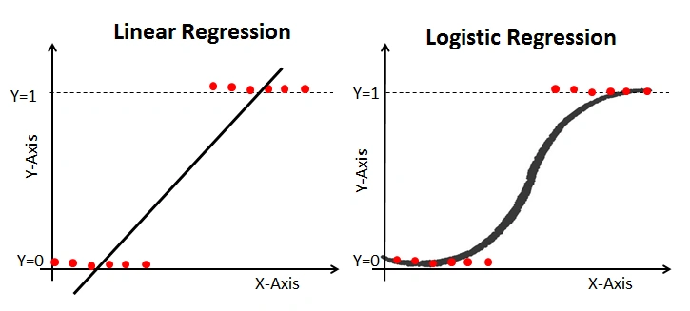
Logistic Regression(session 3.8)
https://www.analyticsvidhya.com/blog/2021/08/conceptual-understanding-of-logistic-regression-for-data-science-beginners/

Slide 19
Recap, OTJ, next week

Slide 20
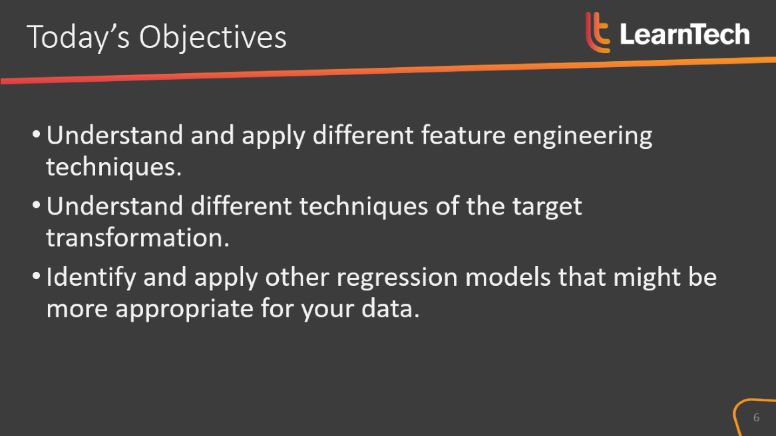
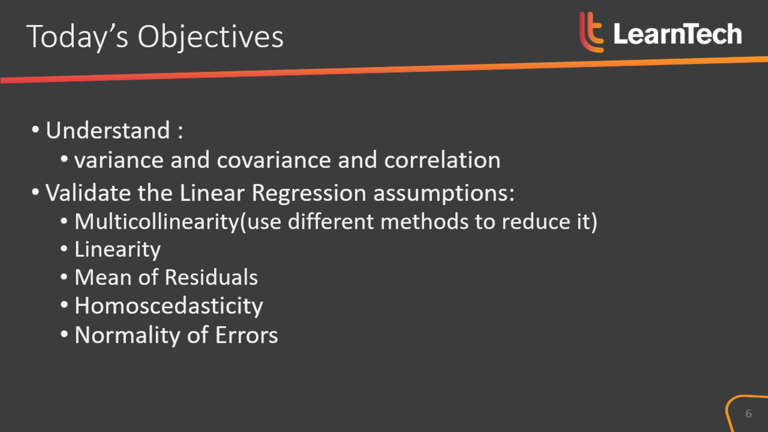
Recap of today’s objectives

Slide 21
OTJ Activity 1
Continue with the house sales project.
Find some time series data at work that you will be able to play around with

Slide 22
OTJ Activity(optional)
Research the following feature engineering techniques:
Handling Outliers
Feature Creation
Handling Missing Values
Feature Interaction

Slide 23

Why are outliers important?
“The book focuses on the extreme impact of rare and unpredictable outlier events—and the human tendency to find simplistic explanations for these events, retrospectively.”
https://en.wikipedia.org/wiki/The_Black_Swan:_The_Impact_of_the_Highly_Improbable
If you read this book, you can log the time spent on it as OTJ time.

Slide 24
Next week…
How to process time series data

